Slide 1
Sentient VOCMS
Volatile Organic Component Monitoring System

Slide 2

Volatile Organic Component

Slide 3
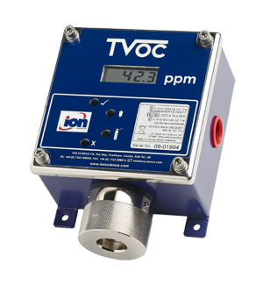
VOC Monitor

